Slide 1
Browser Wars 2.0
A short history of JavaScript in the browser

Slide 2
Browser Wars 1.0
In the last module, you learned about the "Browser Wars".
However, the end of Netscape and the rise of Microsoft's Internet Explorer was not the end of the story...
From Netscape's ashes rose "Browser Wars 2.0"

Slide 3
Browser Wars 2.0 - Firefox
To cut a long story short, Microsoft's dominance gave it little incentive to keep up with new developments.
Link: https://www.theguardian.com/global/2015/mar/22/web-browser-came-back-haunt-microsoft
After Netscape stopped operating, its codebase was open-sourced, and donated to the non-profit Mozilla Foundation in 2003.
In 2004 Mozilla released Firefox, an open-source browser, gaining a 30% market share by 2008.

Slide 4
Google Chrome & JS in the browser
In the same year as Firefox was released (2004), Google pioneered the first Single Page Application (SPA), with Gmail.
Users no longer had to refresh to see new mail.
From the popularity of Gmail, Google concluded that future web browsers would need JavaScript to work quickly and efficiently in the browser, to power complex SPAs.
From this principle, Google built the fast, open-source V8 JavaScript engine, for running JS in the browser.

Slide 5
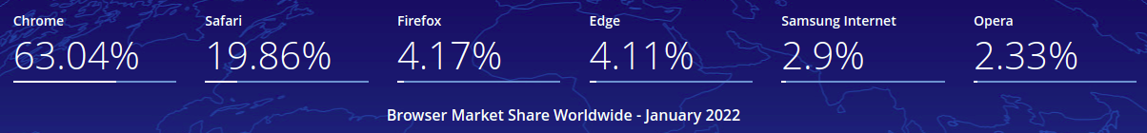
The Rise of Google Chrome
The V8 JavaScript engine powered Google's Chrome browser, which was released in 2008.
By 2016 Chrome had grown to 57% of the desktop browser market. By 2022, it was over 63%. In short, by 2016, Google had “won” Browser Wars 2.0.
  Link: https://gs.statcounter.com/browser-market-share

Slide 6
JavaScript in the browser today
Chrome's rise was powered by a strong and innovative focus on running JavaScript in the browser.
The performance of the V8 JavaScript engine was much better than any previous engine. Google's competitors realized that they also had to innovate in this area to keep up with Chrome.
These days, all major browsers have powerful JavaScript engines ("a program built to run JavaScript in the browser"). The most famous current JavaScript engines are:
V8 (for Chrome)
SpiderMonkey (for Firefox)
Chakra (for Edge)

Slide 7
Modern JavaScript and React
Meanwhile, JavaScript has continued to rise in popularity, to become the most popular programming language in the world today.
In 2019, JS was used to build 95.2% of the world's websites (1.52 billion).
A series of powerful frameworks and libraries have been created, to help developers build JS web apps.
These include Angular, Vue, Ember… and the most popular of all in 2022 - React!

